Slide 1


Organizational Behavior
(MGT-502)
Lecture-11

Slide 2
Summary of
Lecture-10

Slide 3
What is Perception?
  A process by which individuals organize and interpret their sensory impressions in order to give meaning to their environment.
Why Is it Important?
  Because people’s behavior is based on their perception of what reality is, not on reality itself.
  The world that is perceived is the world that is behaviorally important.

Slide 4
Factors Influencing Perception
The Perceiver
The Target
The Situation

Slide 5
Factors that Influence Perception
Factors in the Perceiver
  Attitudes
  Motives
  Interests
  Experience
  Expectations
Factors in the situation
  Time
  Work setting
  Social setting
Perception
Factors in the target
  Novelty
  Motion
  Sounds
  Size
  Background
  Proximity

Slide 6
Today’s Topics

Slide 7
Perception, Attitudes, and Personality
Attitudes
Perception
Behavior
Personality

Slide 8
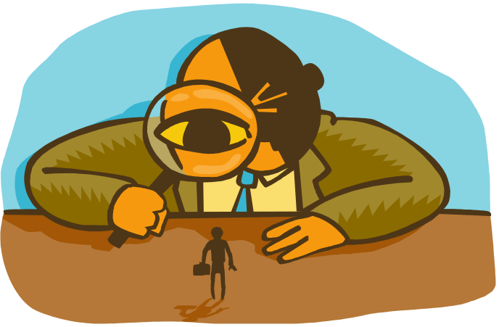
Person Perception: Making Judgments about others

Slide 9
Attribution
The Process through which individuals attempt to determine the causes of others behavior

Slide 10
The “Causes”
Assigning a cause helps to make sense of initial behavior
Was the behavior a real desire or was it from outside pressure??
Internal (personality, motives) causes
External (other people, situation) causes

Slide 11
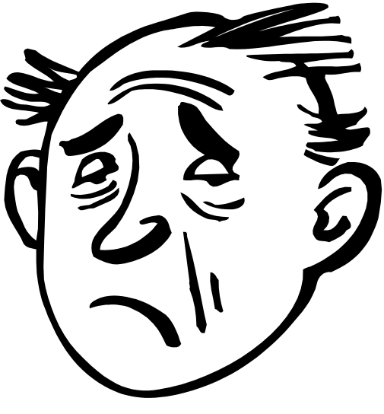
Attributions - Consequences
Subsequent behaviors
Emotions
Feelings
Attitudes

Slide 12
The Attribution Process
Information
Beliefs
Motivation
Perceived external
or internal causes
of behavior
Behavior
Feelings
Expectations

Slide 13
Attribution Theory
Attribution theory - explains how individuals pinpoint the causes of their own behavior or that of others
Information cues for attribution information gathering
  consensus
  distinctiveness
  consistency
Notes:
25
25

Slide 14
Person Perception: Making Judgments About Others
Distinctiveness: Shows different behaviors in different situations.
Consensus: Response is the same as others to same situation.
Consistency: Responds in the same way over time.

Slide 15
Interpretation
Attribution
of Cause
Observation
High
External
Distinctiveness
Attribution
Theory and
Individual
Behavior
Low
Internal
High
External
Consensus
Low
Internal
High
External
Consistency
Low
Internal

Slide 16
Kelley’s Theory of Causal Attribution
The approach suggesting that people will believe others actions to be caused by internal or external factors.

Slide 17
Fundamental Attribution Error
The tendency to attribute others’ actions to internal causes (e.g their traits) while largely ignoring external factors that also may have influenced their behavior.

Slide 18
Self-Serving Bias
  The tendency for individuals to attribute their own successes to internal factors while putting the blame for failures on external factors.

Slide 19
Frequently Used Shortcuts in Judging Others
Selective Perception
  People selectively interpret what they see on the basis of their interest, background, experience, and attitudes.
Halo Effect
  A general impression about an individual is based on a single positive characteristic.
Contrast Effects
  Evaluations of a person’s characteristics that are affected by comparisons with other people recently encountered who rank higher or lower on the same characteristics.
Projection
  Attributing one’s own characteristics to other people
Stereotyping
  Judging someone on the basis of the group to which he/she belongs.

Slide 20
Specific Applications in Organizations
Employment Interview
  Perceptual biases affect the accuracy of interviewers’ judgments of applicants.
Performance Expectations
  Self-fulfilling prophecy: A situation in which one person inaccurately perceives a second person and the resulting expectations cause the second person to behave in ways consistent with the original perception.
Performance Evaluations
  Appraisals are subjective perceptions of performance.
Employee Effort
  Assessment of individual effort is a subjective judgment subject to perceptual distortion and bias.

Slide 21
Perception and Performance Appraisal
Objective and Subjective Measures
  Higher in the organizational hierarchy, it becomes more difficult to find objective measures or quantifiable evidence to use to measure performance.
  Therefore, organizations rely on subjective measures of effectiveness provided by managers.

Slide 22
Rater Errors
Leniency – The tendency to perceive the job performance of ratees as especially good.
Harshness – The tendency to perceive the job performance of ratees as especially ineffective.
Central tendency – The tendency to assign most ratees to middle-range job performance categories.

Slide 23
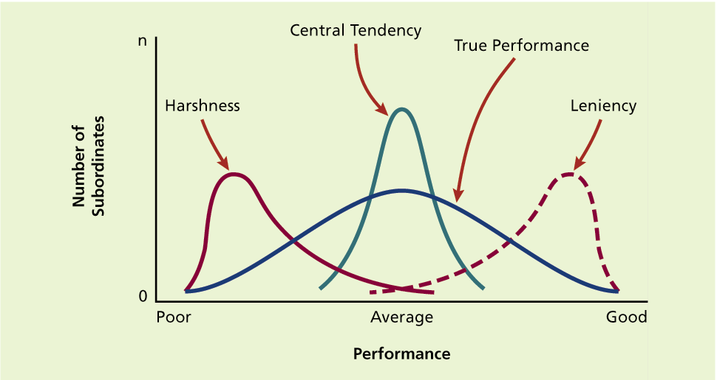

Slide 24
Halo effect – The rating of an individual on one trait or characteristic tends to colour ratings on other traits or characteristics.
Similar-to-me effect – A rater gives more favourable evaluations to people who are similar to the rater in terms of background or attitudes.

Slide 25
Misperception
Misperception is the cognitive process by which an individual selects and organizes, but misinterprets, environmental stimuli.

Slide 26
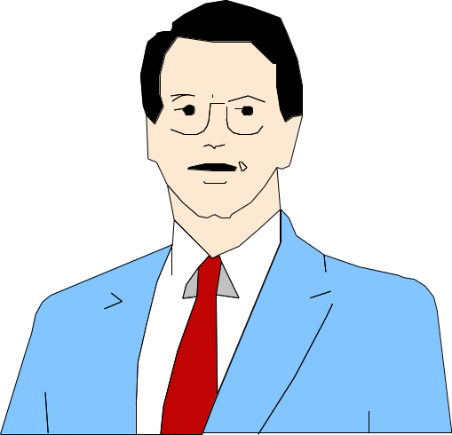

Impression Management
Self-presentation
Is the process by which people attempt to manage or control the perceptions other form of them.

Slide 27
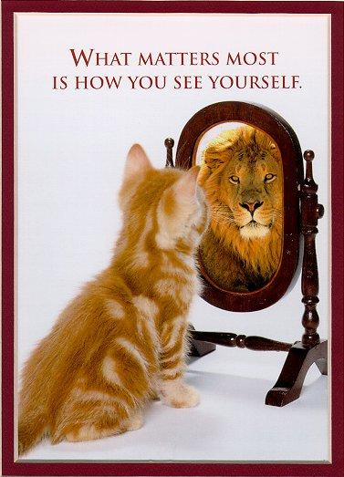

Slide 28
Employee Impression Management Strategies
Demotion-preventative strategies
    Accounts
    Apologies
    Disassociation
Promotion-enhancing strategies
    Entitlement
    Enhancement
    Obstacles disclosures
    Association

Slide 29
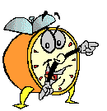
Let’s stop it here

Slide 30
Summary

Slide 31
Attribution
The Process through which individuals attempt to determine the causes of others behavior

Slide 32
Fundamental Attribution Error
The tendency to attribute others’ actions to internal causes (e.g their traits) while largely ignoring external factors that also may have influenced their behavior.

Slide 33
Frequently Used Shortcuts in Judging Others
Selective Perception
  People selectively interpret what they see on the basis of their interest, background, experience, and attitudes.
Halo Effect
  A general impression about an individual is based on a single positive characteristic.
Contrast Effects
  Evaluations of a person’s characteristics that are affected by comparisons with other people recently encountered who rank higher or lower on the same characteristics.
Projection
  Attributing one’s own characteristics to other people
Stereotyping
  Judging someone on the basis of the group to which he/she belongs.

Slide 34
Impression Management
Self-presentation
Is the process by which people attempt to manage or control the perceptions other form of them.

Slide 35
Next….

Slide 36
Perception & Decision Making

Slide 37
Organizational Behavior
(MGT-502)
Lecture-11

